Slide 1
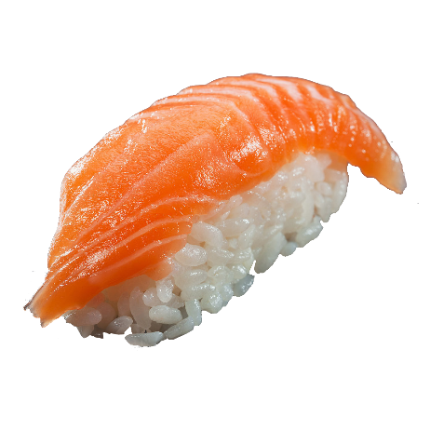
Japan
10905 안송주
10906 유지연
이세미
10908 이주연

Slide 2
CONTENTS
1.
2.
3.
4.
Festival & Holiday
Entertainment & sports
Food
Clothing

Slide 3
Aomori Nebuta Matsuri 8.2~8.7
Festival & Holiday
Sapporo Snow
1.31~2.11

Slide 4
Festival & Holiday
the birthday of the Emperor
12.23

Slide 5


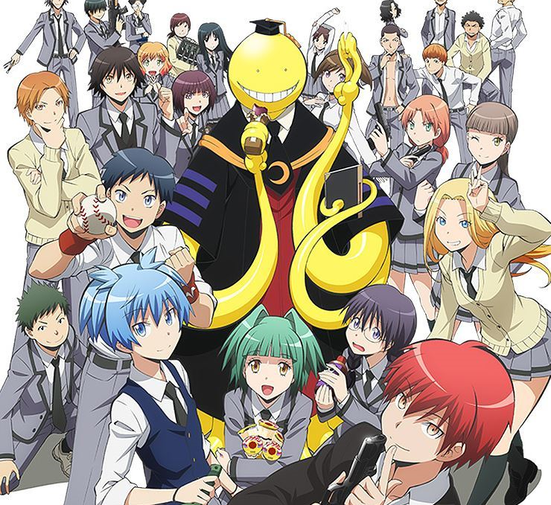
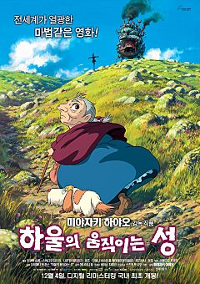
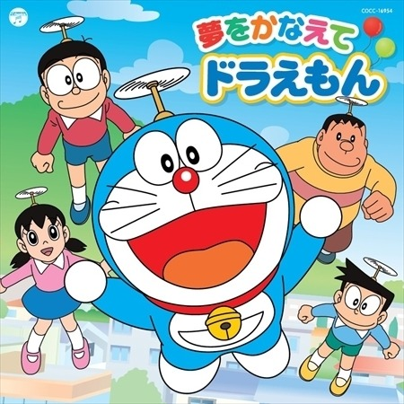

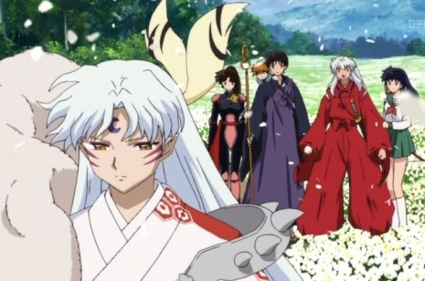

Animation
A movie that uses a cartoon or a doll to make it feel as if it were alive.
Inuyasha
a​ssassination class
Doraemon

Slide 6
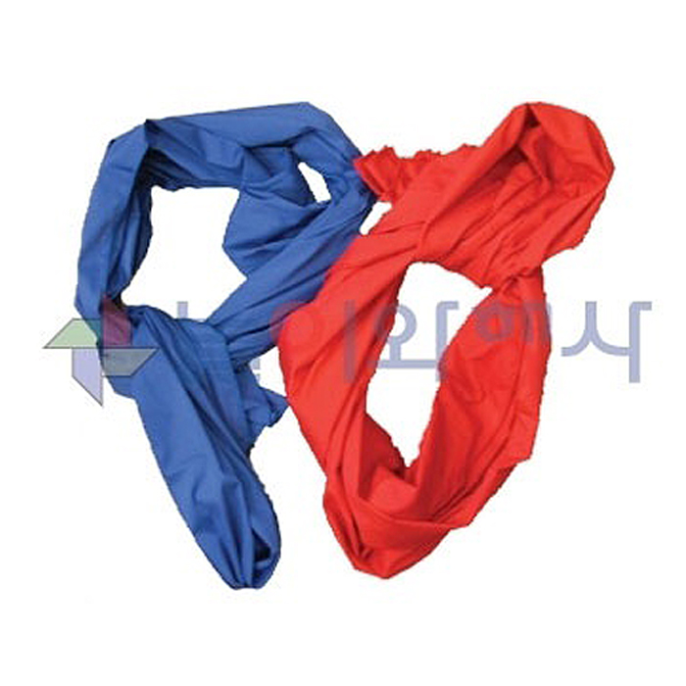
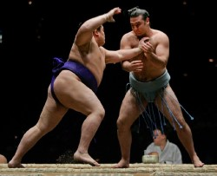
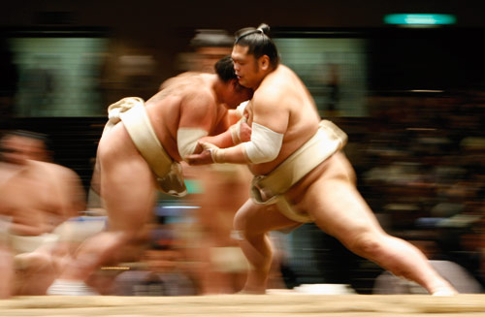
Sumo
-Traditional Japanese wrestling
saba
VS

Slide 7
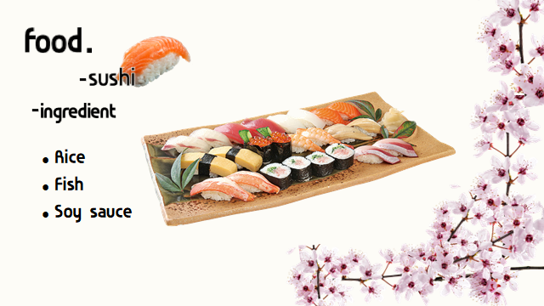
Food
32%
18%

Slide 8
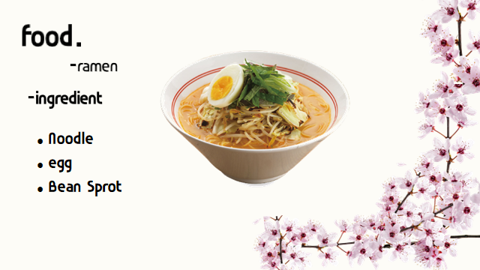
Food
32%
18%

Slide 9
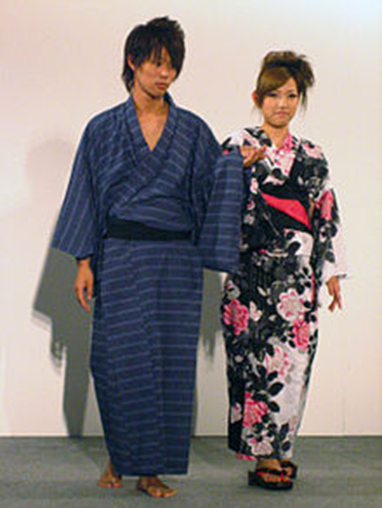
Clothing
Yukata

Slide 10
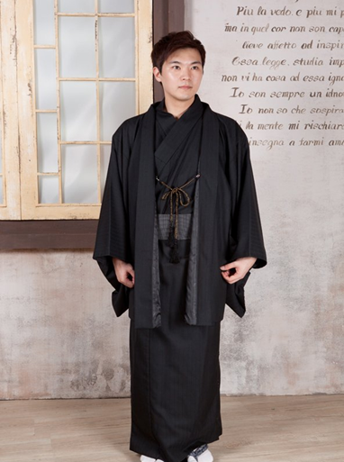
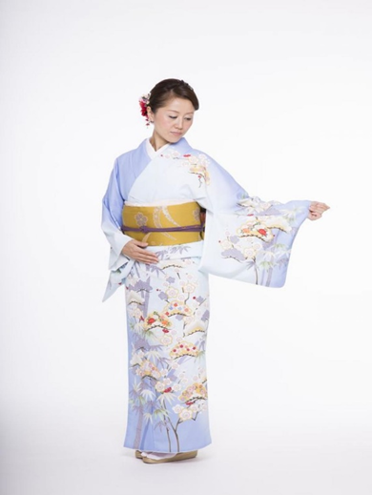
Clothing
Men
Women
kimono

Slide 11
ThNK YOU

